Slide 1
Image Forensics
Anti-Forensics and Counter Anti-Forensics

Slide 2
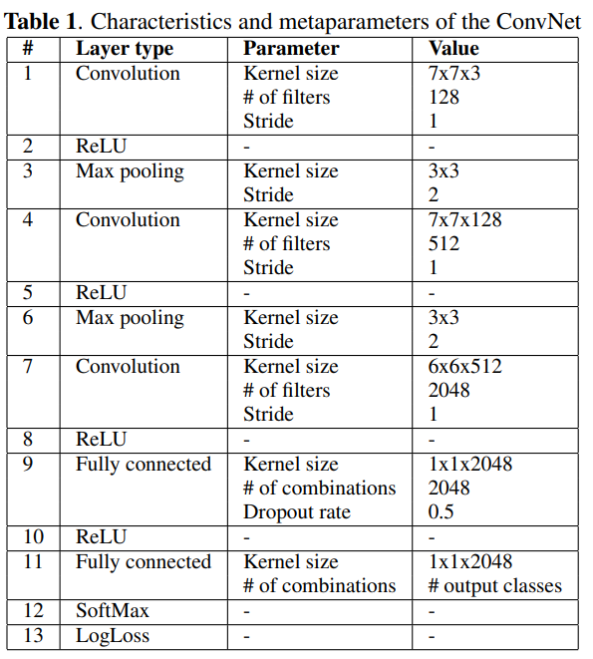
Image Forensics
Deep learning-based approaches learn features characterizing each camera directly from the acquired pictures.
It is conceptually similar to image classification.
For instance-level recognition, a label indicating a particular device instance, whereas for model-level recognition, a label indicating the model of the camera.
Camera identification with deep convolutional networks, 3 Mar 2016

Slide 3
Anti-Forensics and Counter Anti-Forensics
Anti-forensics aim to make forensics algorithms fail by modifying the images in a visually imperceptible way.
According to the study, deep learning-based approaches are vulnerable to adversarial attacks.
Counter anti-forensics methods defend against anti-forensics techniques by improving the robustness of image forensics.

Slide 4
Adversarial Attacks
Several machine learning models misclassify examples that are only slightly different from correctly classified examples.
In many cases, a wide variety of deep learning models misclassify the same adversarial example.
Early attempts at explaining this phenomenon focused on nonlinearity and overfitting.
The explanation that adversarial perturbation is their linear nature was supported by quantitative results.
Explaining and Harnessing Adversarial Examples, 20 Mar 2015
Notes:
다른 아키텍처라도 같은 적대적 예제가 유효함.
선형성 때문이란 게 무슨 말인지 설명

Slide 5
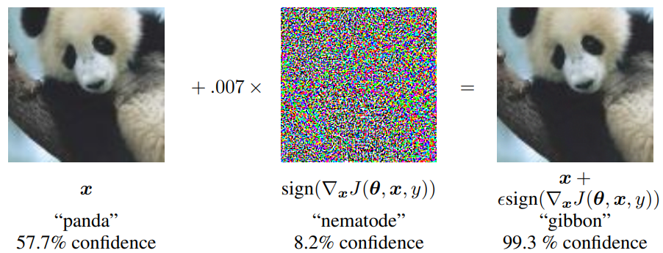
Adversarial examples
Adversarial examples are specialized inputs created with the purpose of confusing a neural network.
These notorious inputs are indistinguishable to the human eye.
FGSM(fast gradient sign method):
Explaining and Harnessing Adversarial Examples, 20 Mar 2015
Notes:
Θ: 모델
X: 입력
Y: X의 정답 라벨
J: 네트워크 학습 시 사용된 손실 함수
▽xJ(θ,x,y): 모델에 x를 집어 넣었을 때 손실함수 값
엡실론: 추가할 노이즈 양
## 말로 할것들
FGSM설명
화이트 박스, 블랙박스 공격 설명

Slide 6
Defenses against adversarial attacks
Until now defenses against adversarial attacks can be broadly divided into three categories:
Adversarial training
Modifying the networks by adding more layers, changing loss and so on.
Employing external models as network add-on when classifying unseen examples.

